Slide 1
Payseur Lab Meeting 7/17/19
April Peterson
Research updates

Slide 2
Chapter 3, Evo. and sexual dimorphism of meiotic features
Meiotic features
SC length, CO position, and interference
Focus male pattern in M.m.muscuslus PWD and KAZ
What differences in features are associated with rapid evolution of gwRR?
MLH1 Counts
PWD
MSM
KAZ

Slide 3
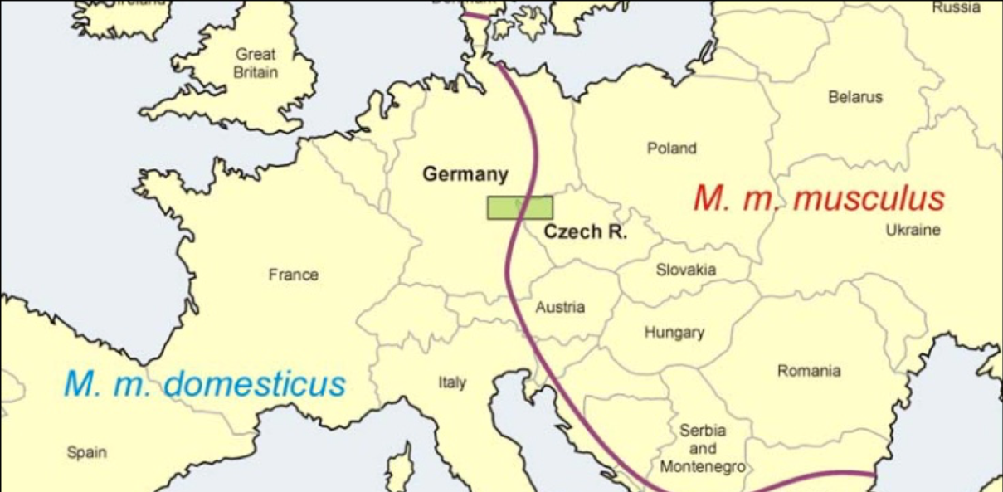
Sampling of M. m. musculus
SKIVE
KAZ
CZECH II
PWD, PWK
https://natureecoevocommunity.nature.com/users/112451-jiri-forejt/posts/33713-chromosomal-reproductive-isolation-revisited
Notes:
Point – state emphazie that looking at disparate Musc strains will be exciting / useful
(connection to evolution of Rec / HetZ) (broaden samples of Musc)
Most studied musc strains are from very close to hybrid zone
(my initial results indicate CZECHII does not have as high a RR
We got – eastern Eurasian musculus, (KAZ is actively breeding now)
Also there is a strain from Denmark – musc nuclear background and Domesticus mitochondria (apparently happened naturally)
SKIVE is a natural conplastic strain combining aM. domesticus mitochondrial genome and a M. musculus nuclear genome. Wild-derived mice are genetically distinct from common laboratory mice for a number of complex phenotypic characteristics and are valuable tools for genetic mapping, evolution and systematics research.

Slide 4
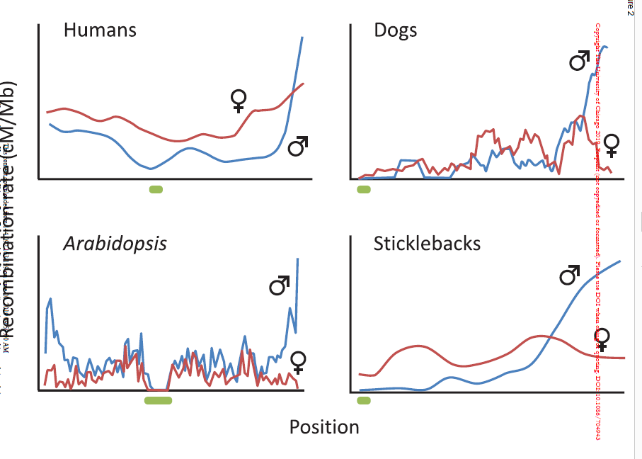
Male-specific Rec Landscape drives evolution
Bivalent level patterns are sexually dimorphic
SACE model; Sexually Anatongistic Cis Epistasis – SA interactions between promotor and genes
Alternative functional models:
Chromosome pairing during bouquet
Balance across metaphase spindle (cohesins)
Sardell and Kirkpatrick, 2019, American Naturalist
Notes:
Goal
Review male landscape
-- applies across all chromsomes in genome,

Slide 5
Feature | Prediction (based on MLH1 count) | Model
SC Length | Longer in PWD | Chromosome Axis is DSB / CO area
Chrm Class (1CO, 2CO) | More 2COs in PWD | gwRR = sum of chromosomes
InterFocal Distance (IFD) (Interference) | Shorter IFD in PWD (weaker inference) | Interference strength
CO Position* 1CO 2CO | No difference | Interference and Regional bias?
*Telomere bias, Centromere suppression* | PWD has weaker centromere suppression | Fit more 2CO landscapes
Notes:
Review the initial predictions across traits
Careful not to make too busy
Assumptions
-no chromosome specific effects
-MLH1 is main pathway

Slide 6
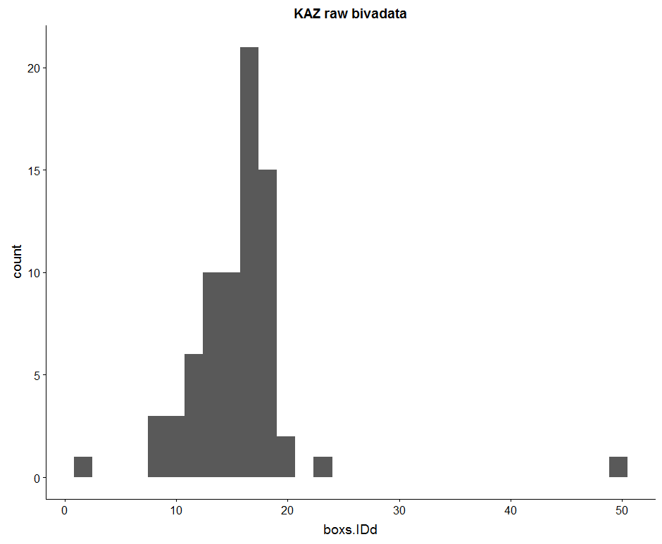
Curation of Auto Bivalent Data
19 autosomes per cell
Curated Dataset | PWD | KAZ
Mice (7-12 weeks) | 4 | 3
Unique cells | 64 | 73
Auto-Bivalents (Total Expected, 19*cells) | 542 (1216) | 740 (1387)
Bivalent hand measures | 68 | 49
Number of whole cells | 10 | 9
Bivalents ID’d per cell
Notes:
Goal
In the automated data, most cells are missing some bivalent measures. Expected bivalents measures is 19 (all autosomes)
Without 19 biv measures per cell, can’t use the rank to separate bivalents
So, making more manual measures of bivalents which were skipped by the automated
(go into process of manual measures?)

Slide 7
results

Slide 8
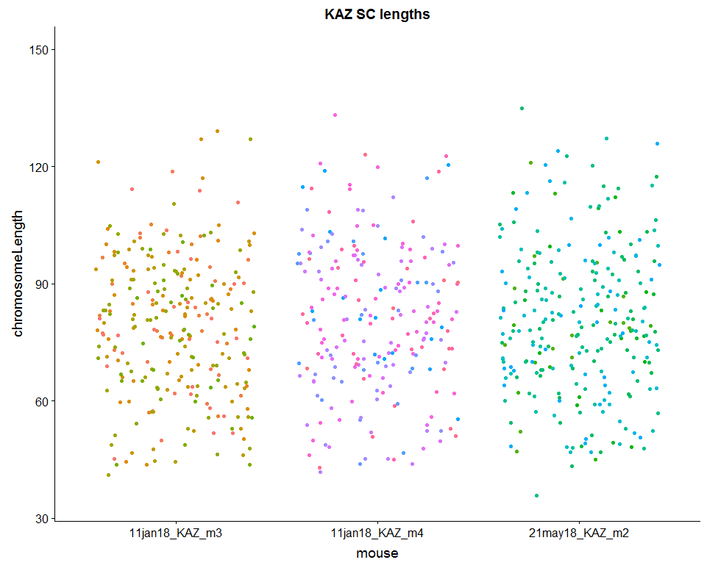
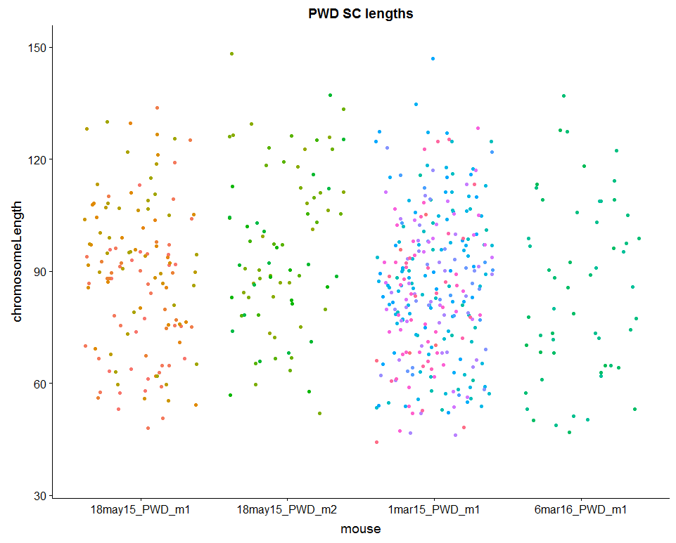
PWD have longer SC lengths
KAZ pooled bivalents
PWD pooled bivalents
78.86 80.99 80.2
88.3 95.75 86.19 84.96
Notes:
(add mean bars, to show that the average
ADD values)
Make a list of young PWD to run through Cyverse again
t.Test of all observations
p-value = 2.285e-12

Slide 9
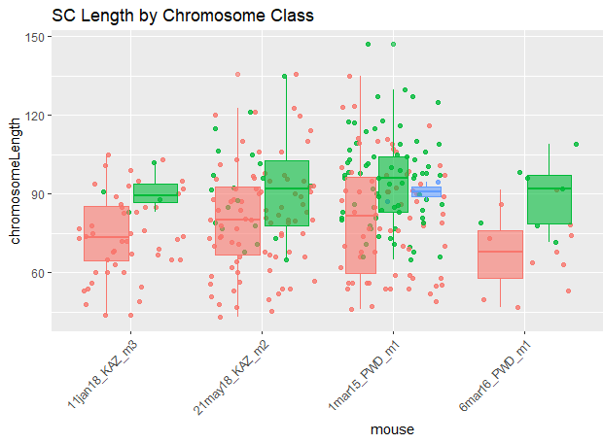
PWD have longer SC and more 2COs
SC Length | p-value
All SC | 2.285e-12
Shortest bin | 0.02131
Longest bin | 0.01495
1CO* | 0.9188
2CO* | 0.009883
Whole cells | PWD n | KAZ n
1CO | 88 (48%) | 132 (84%)
2CO | 91 (50%) | 24 (15%)
3CO | 2 (1%)
KAZ
PWD
Notes:
Are PWD 2COs longer than KAZ 2COS?
Most all 2COs are longer than 1COs
There is some overlap
Kaz means 78.86 80.99 80.2
PWD means 88.3 95.75 86.19 84.96

Slide 10
Interference, Interfocal Distances
Raw Interfocal Distance (IFD) can be similar and normalized is different; .rbar values would be different, telomere/centromere bias might be different.
Noting the normalized IFD accounts for differences between different sized chromosomes.
Notes:
(review difference between nrm and

Slide 11
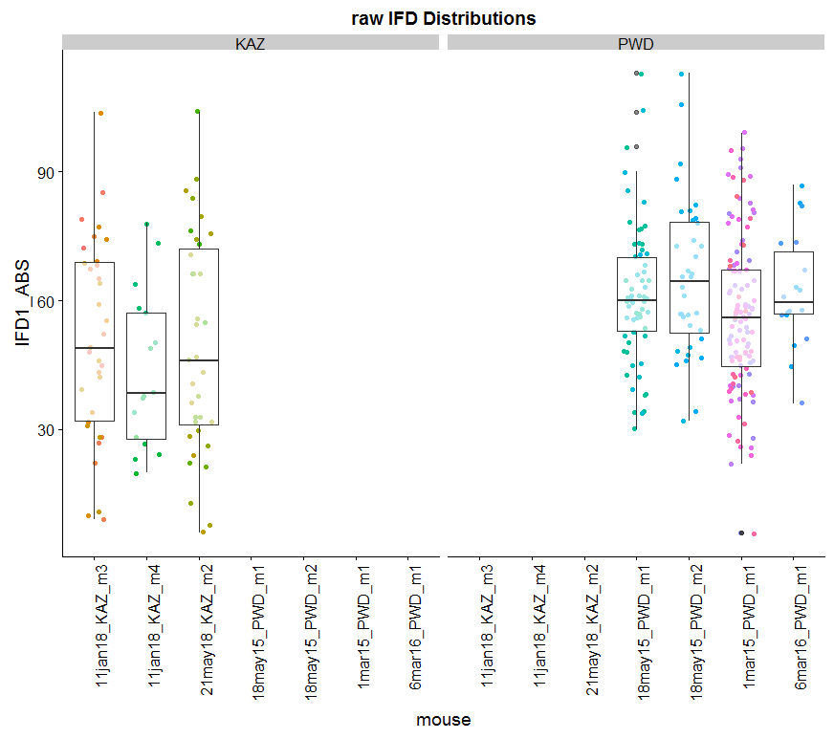
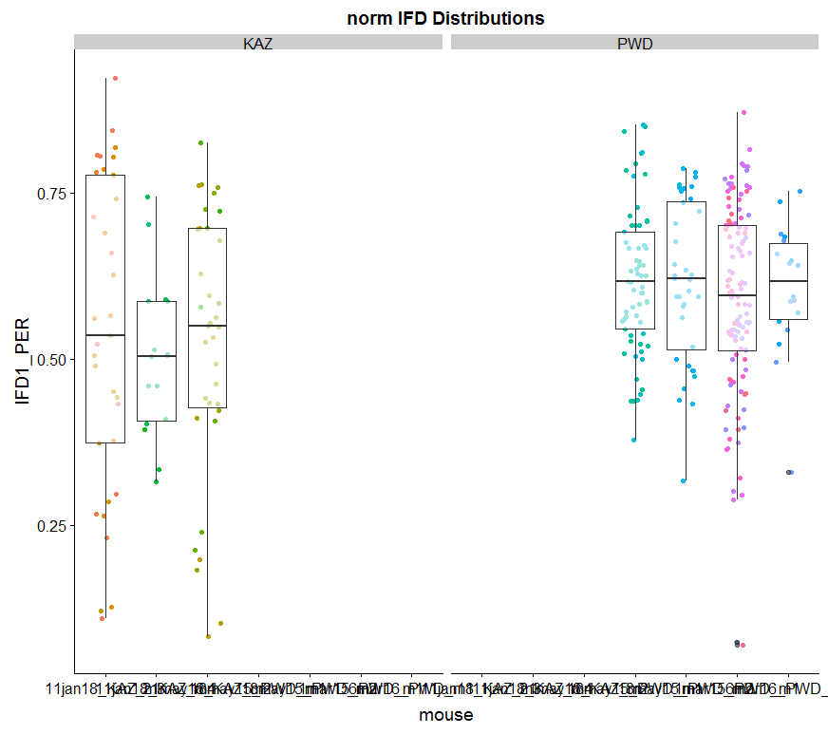
PWD have longer IFD
KAZ
PWD
KAZ
PWD
Notes:
KAZ the average IFD distance is 50% of bivalent
PWD the average IFD is ~60%
How much of an effect does subsampling have
What are the pvalues for these

Slide 12
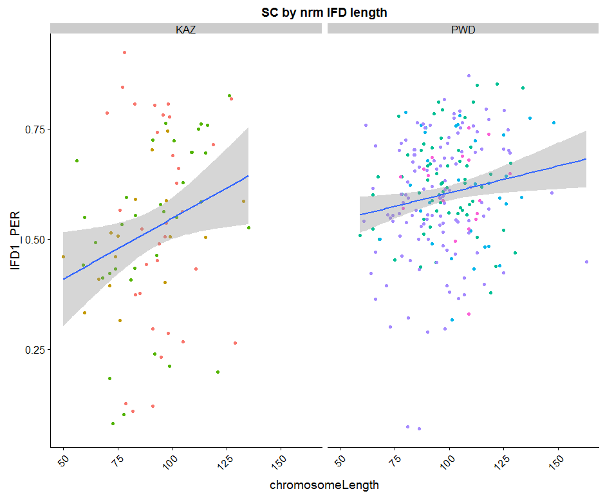
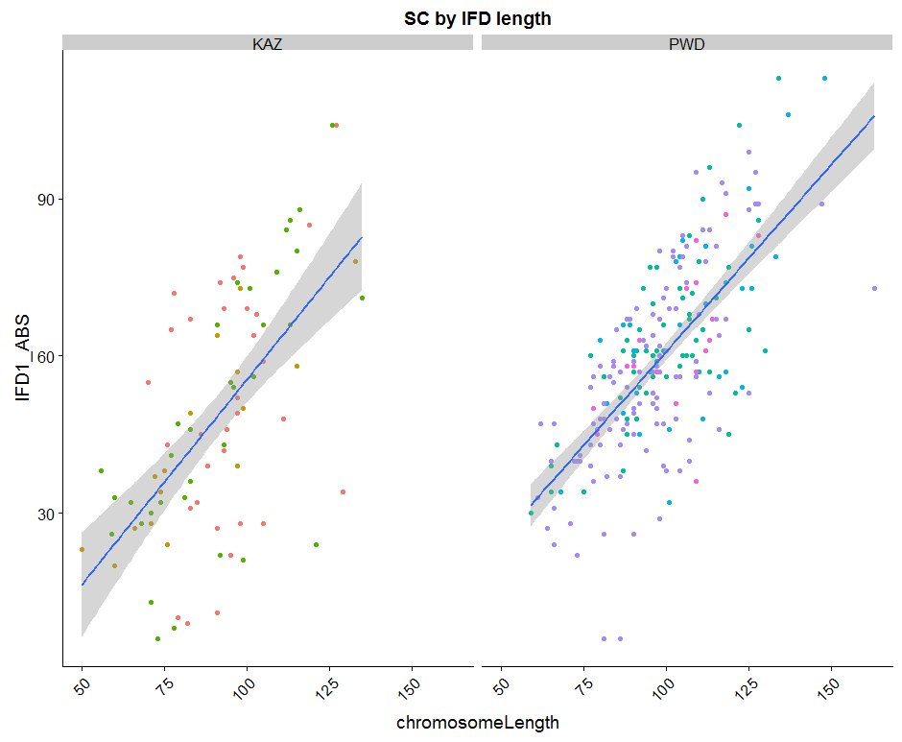
Normalized IFDs are larger in PWD
KAZ
PWD
KAZ
PWD
Raw IFD
Normalized IFD
The distance between 2 foci is ~60% of the total bivalent in PWD
KAZ has more variance in IFDs
Notes:
The ranges of normalized IFDs is smaller
Weak slope for IFD.PER and SC length in PWD indicates weaker SC ~ IFD.PER relationship. No matter what the length of Biv in PWD, IFD will be arounf the mean
Stronger slope for KAZ indicates that shorter bivs have shorter nrm IFDs, and longer bivalents have longer nrmIFDs.
The range for the PER/nrm is larger in KAZ,
Larger variance for KAZ for IFDs (Stronger interference in KAZ)
nrmIFD is more consistent in PWD, and more dynamic (across bivalents) in KAZ
<try dividing up by chrm size bins>

Slide 13
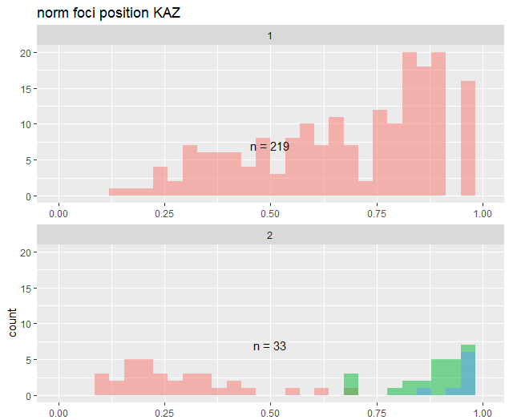
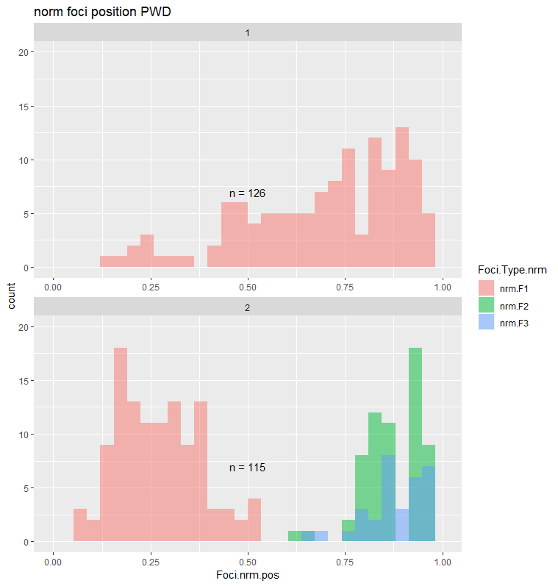
No Difference in Average
Normalized CO Positions
t.test | p.value
1CO | 0.5468
2CO 1st | 0.9421
2CO 2nd | 0.5403
KAZ
PWD

Slide 14
Feature | Prediction (based on MLH1 count) | Model | Supported?
SC Length | Longer in PWD | Chromosome Axis is DSB / CO area | Yes
Chrm Classes (1CO, 2CO) | More 2COs in PWD | gwRR = sum of chromosomes | Yes
InterFocal Distance (IFD) (Interference) | Shorter IFD in PWD (weaker inference) | CO- Interference | No* (haven’t looked across bins)
CO Position 1CO 2CO | No difference | ? | Yes* (haven’t looked across bins)

Slide 15
SKIVE
KAZ
CZECH II
PWD, PWK
https://natureecoevocommunity.nature.com/users/112451-jiri-forejt/posts/33713-chromosomal-reproductive-isolation-revisited
Notes:
Point – state emphazie that looking at disparate Musc strains will be exciting / useful
(connection to evolution of Rec / HetZ) (broaden samples of Musc)
Most studied musc strains are from very close to hybrid zone
(my initial results indicate CZECHII does not have as high a RR
We got – eastern Eurasian musculus, (KAZ is actively breeding now)
Also there is a strain from Denmark – musc nuclear background and Domesticus mitochondria (apparently happened naturally)
SKIVE is a natural conplastic strain combining aM. domesticus mitochondrial genome and a M. musculus nuclear genome. Wild-derived mice are genetically distinct from common laboratory mice for a number of complex phenotypic characteristics and are valuable tools for genetic mapping, evolution and systematics research.

Slide 17
Test if these are partially accurate

Slide 18
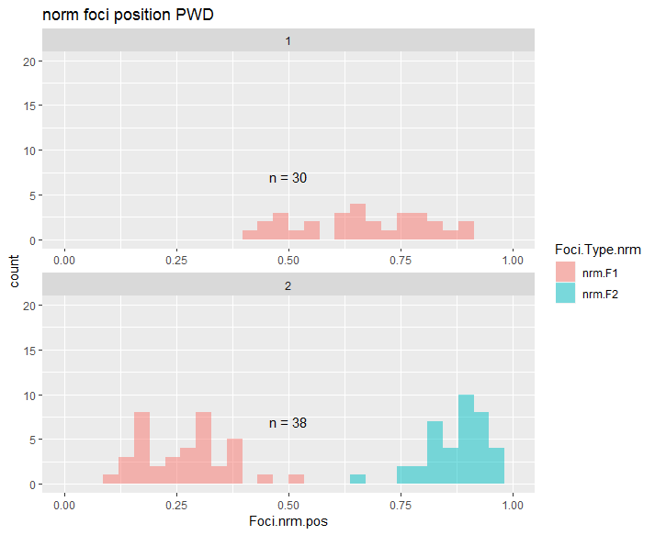
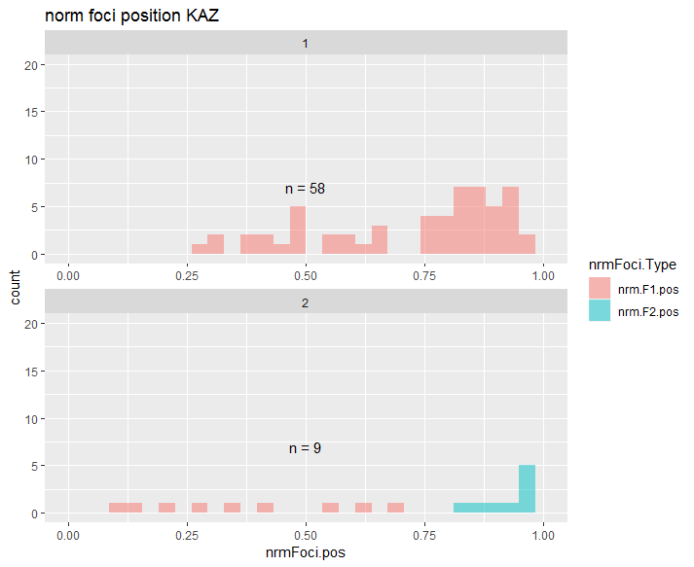
Notes:
Subsampled the KAZ data to a similar sample size
(PWD has longer SC)
(PWD have more 2COs)

Slide 19
Test the correlation between single cell measures and multi-cell measures
Notes:
7feb18_11jan18_KAZ_m4_sp1_26_rev_10

Slide 20
Test if kinks affect SC length
Notes:
26jan18_11jan18_KAZ_m3_sp1_15_rev_5

Slide 21
Target mice
 | weeks | Check Biv
18may15_PWD_m1 | 7 | Y
18may15_PWD_m2 | 7 | Y
1apr16_PWD_m3 | 7.571429 | N
6mar16_PWD_m1 | 7.857143 | N
1apr16_PWD_m1 | 8.571429 | N
1apr16_PWD_m2 | 8.571429 | N
1mar15_PWD_m1 | 11.57143 | Y
 | weeks | Check Biv
21may18_KAZ_m2 | 7
30may18_KAZ_m1 | 8.285714
30may18_KAZ_m2 | 8.285714
30may18_KAZ_m3 | 8.285714
4dec17_KAZ_m1 | 8.857143
11jan18_KAZ_m2 | 9.714286
11jan18_KAZ_m3 | 9.714286 | Y
11jan18_KAZ_m4 | 9.714286 | Y
21may18_KAZ_m1 | 10 | Y?
11feb18_KAZ_m1 | 11
Notes:
Try to make sure I have BivData from these mice

Slide 22
Use RW’s algorithm data?

Slide 23
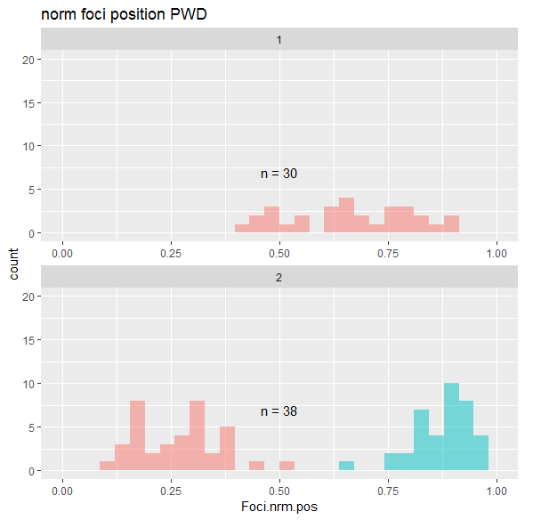
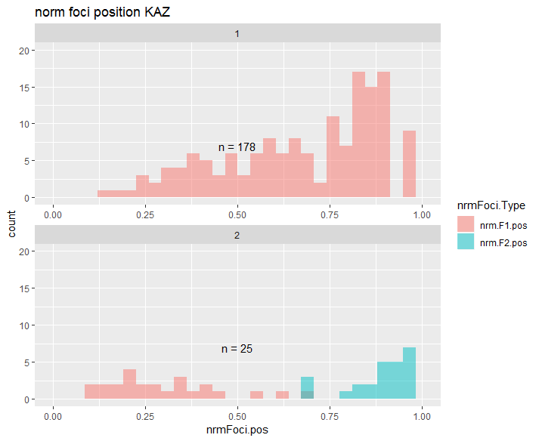
Normalized positions
Notes:
This result needs to be confirmed with more PWD data

Slide 24
Background of CO patterning
4 chromosomes, average of 8 COs per nucleus
3 phenomena of recombination positions
Obligatory CO
>1 CO per chromosome (arm)
Positive interference
Even spacing of COs
3. CO homeostasis
Nonlinear relationship between precursors and mature COs
Notes:
Example of how cells don’t look
10 COs on 4 chrms, localized on 2 chrms,
localized on 1 chrm, no spacing
Second point – even spacing across all chrms
CO spacing regulated
2) Instead what is seen are
1. even spacing
2. >1 per chrm
3. more percursors, DSBs than final CO. non linear relationship between COs and precursors
3) Three phenomena
2. 3.
Positive interference and obligatory CO thought to place a large role in the averge genome wide rate of recombination
CO homeostasis <reflects that the decision between CO and NCO acts to maintain a optimal number of COs per a cell>

Slide 25
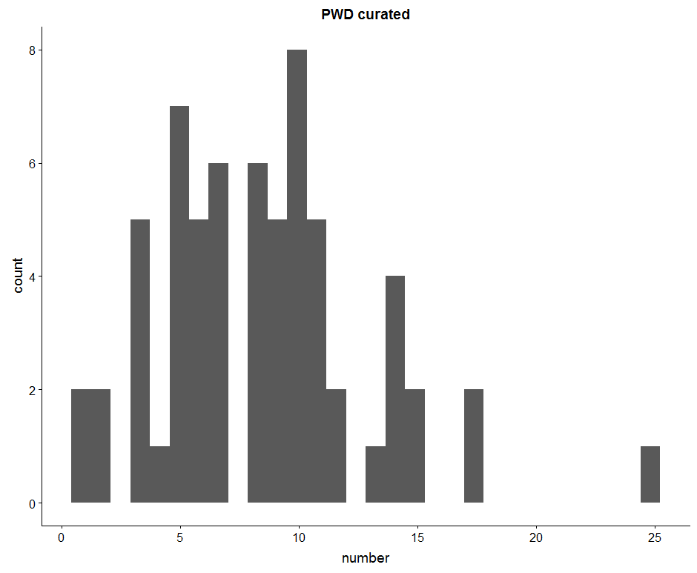
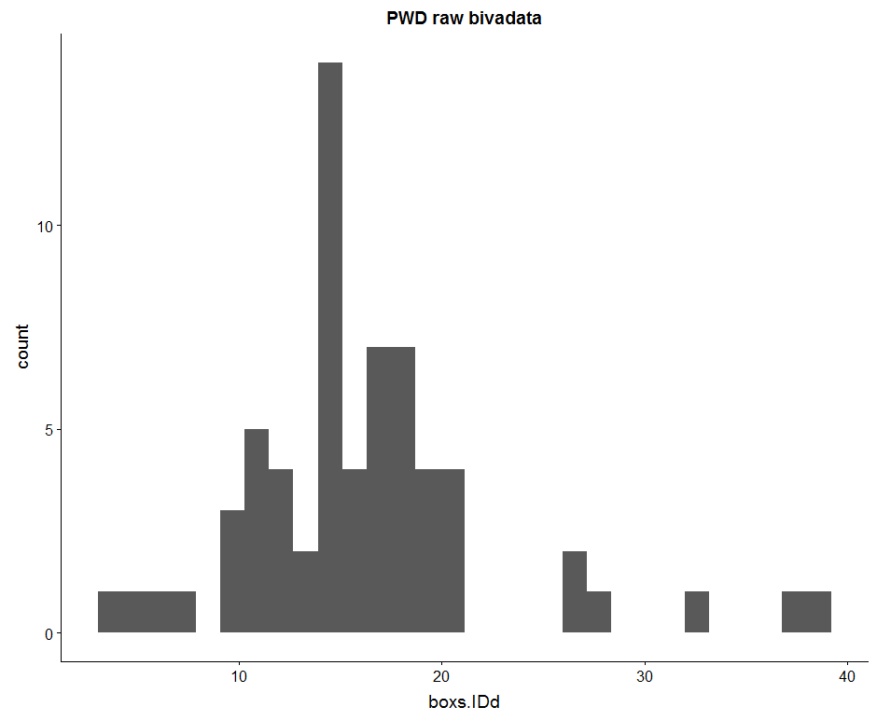

Slide 26
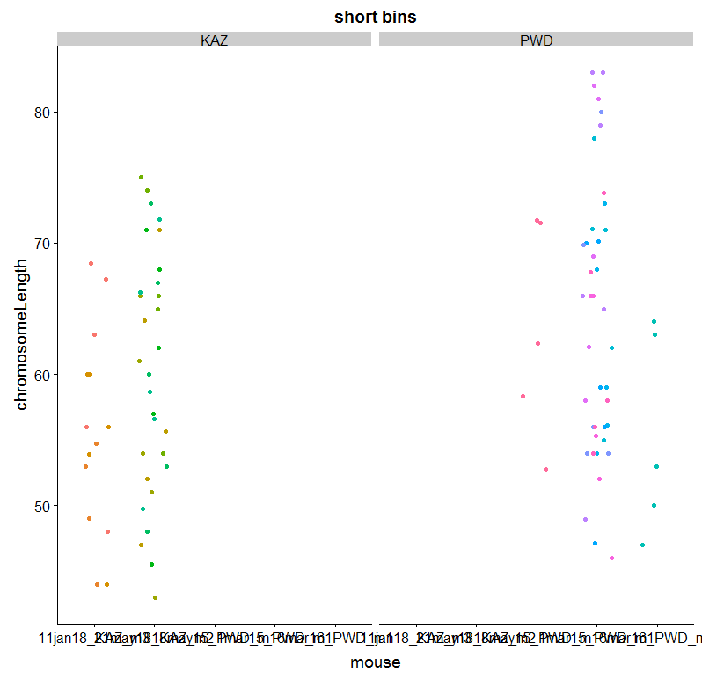

Slide 27
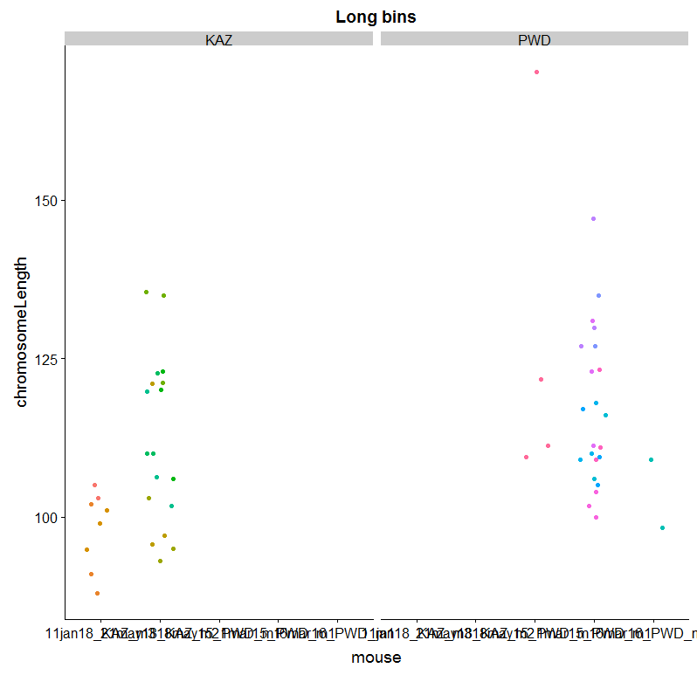
Binned, SC lengths (from each cell take the shortest and longest 5)
#p-value = 0.02131
p-value =
Notes:
(when use more comparable measures – short and long bins of bivalents
The difference is less significant)

Slide 28
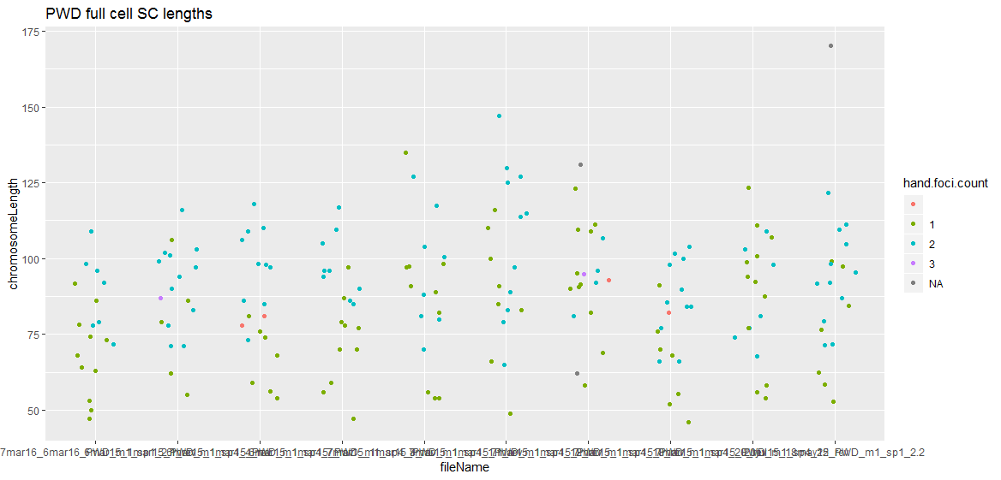
Notes:
This plot is too busy --- not sure what the point is
Within cells most

Slide 29
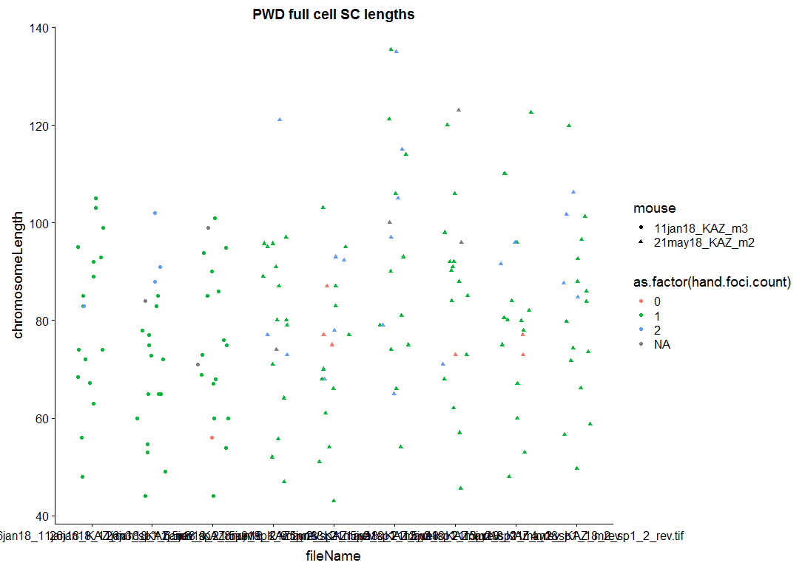

Slide 30
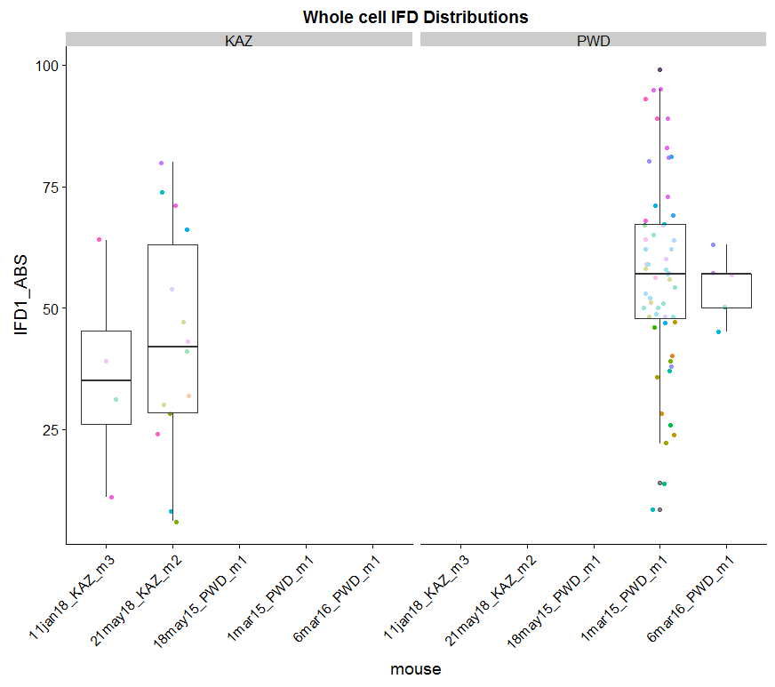
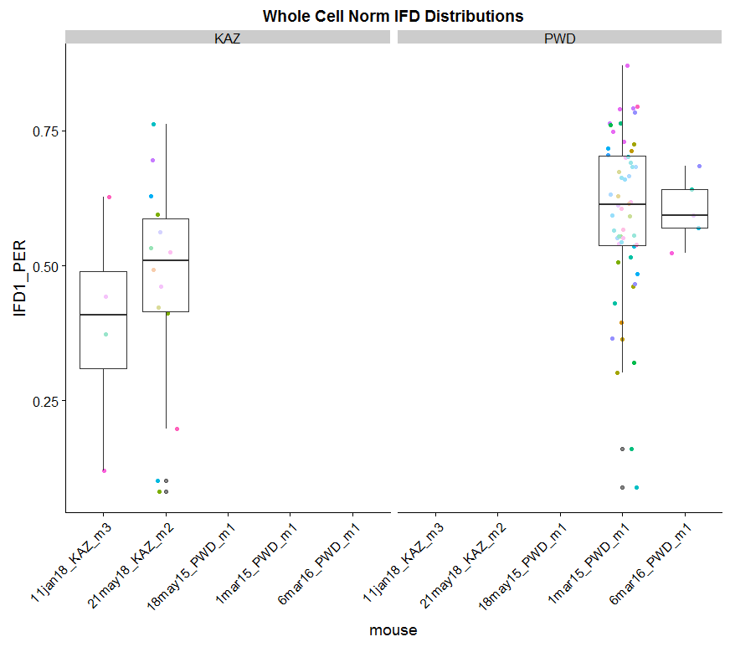
Notes:
I should just compare the 2 mice with most observations
KAZ, average IFD distance is 50% or less of total bivalent

